Slide 1
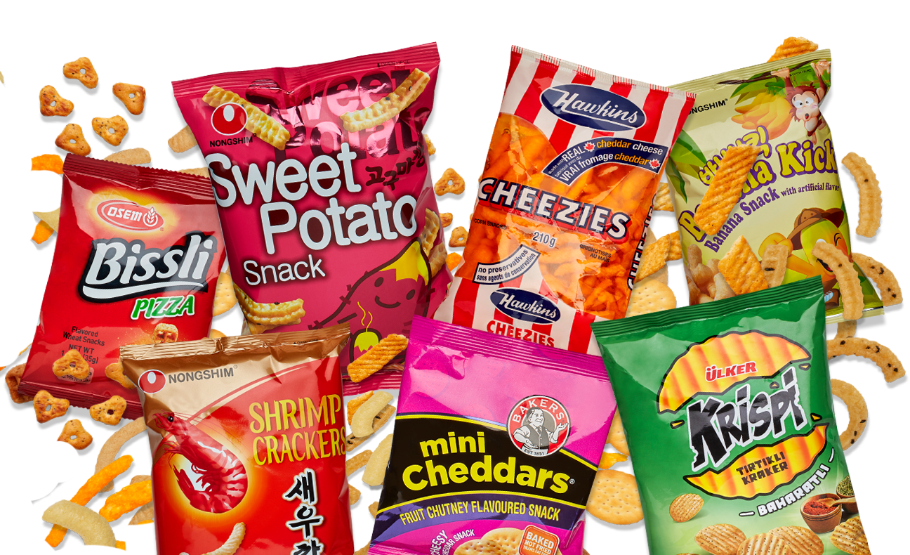
PodKnow:
Data Statistics
Harini Booravalli
Christopher Edgecombe
Jeremy Hudson
Jamie Weathers
Kun Vincent Yang
Team Snack Overflow

Slide 2
Tasks Breakdown
Harini
Statistics and patterns observed in single words
LSA model applied on single words
LSA visualization and efficiency (in progress)
Christopher
Topic modeling using LDA for single words.
Visualization of LDA Model (Words)
Finding dominant topic (In-Progress)
Jeremy
Topic modeling using LDA with bigrams
Experimentation with different methods of creating bigrams
Statistical analysis using bigrams

Slide 3
Tasks Breakdown
Vincent
Google Statistics analysis of audio file length and transcription cost.
Jamie
New Collector app that includes valuable information (Confidence scores, audio length, etc..)
Analysis of Confidence Score Data
Notes:
Collector Application and Google Stats.

Slide 4
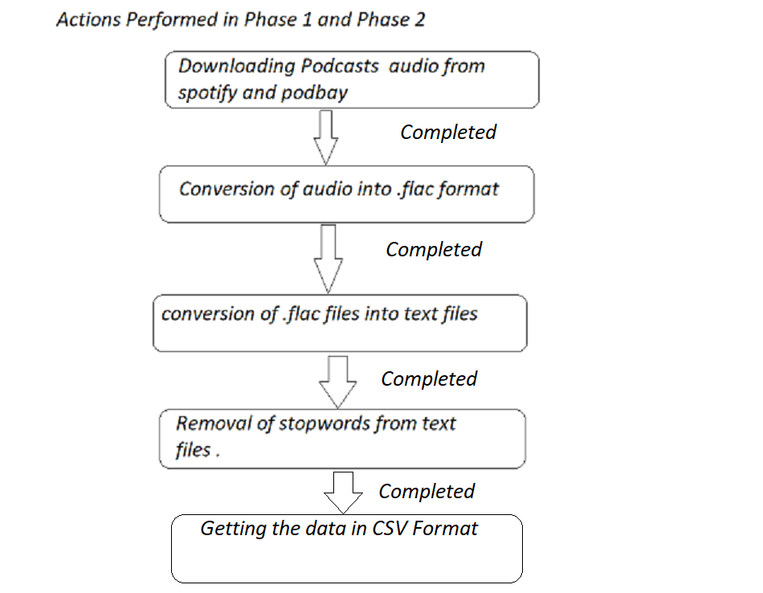
Harini
Introduction

Slide 5
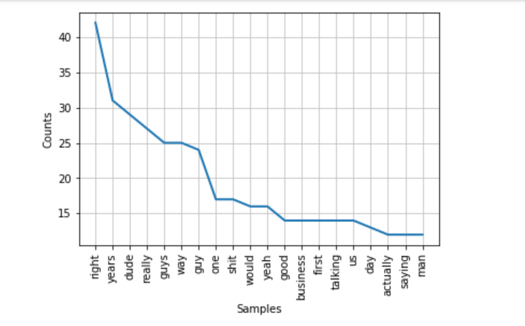
Harini
Statistics and patterns observed in single words
Statistical Observation----->Tf-IDf------->LSA
mean,distribution----->LSA mode(coherence))
Considering the single words from podcasts after stop words removal.Performed it on all the podcasts.

Slide 6
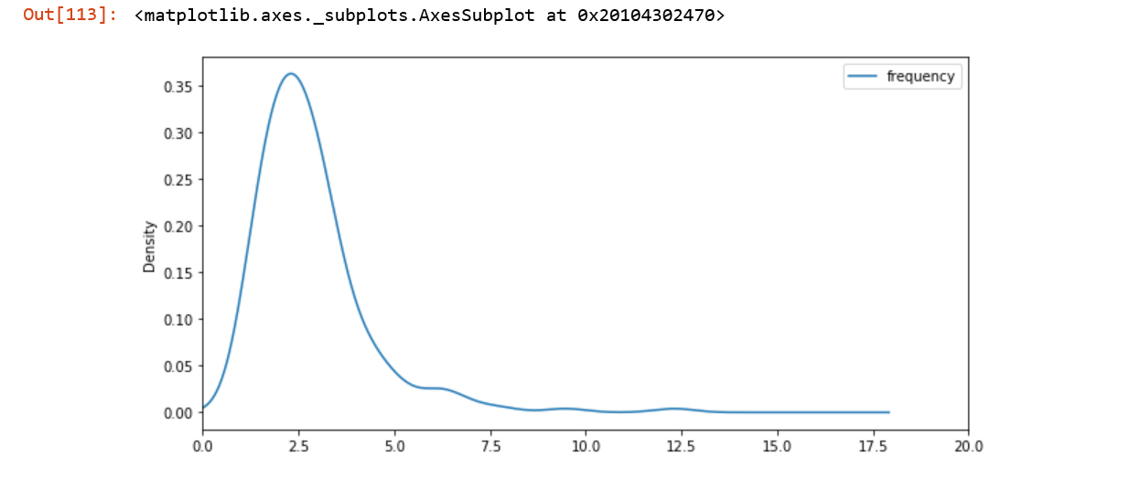
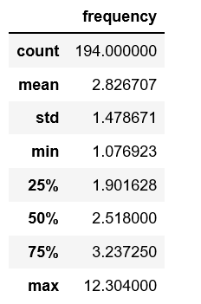
Harini
Statistics and patterns observed in single words
Mean frequency of words on all podcasts.

Slide 7
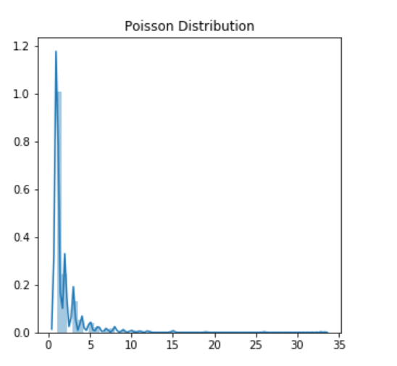
Harini
Distributions:-
Graph :- Word frequency v/s number of words
Poisson distribution applied.
Frequency of words and Number of words is discrete
Mean:- 2.016 ,SD:- 2.398

Slide 8
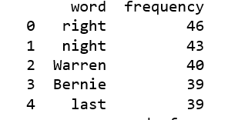
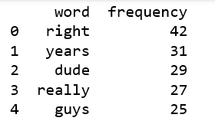
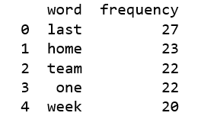
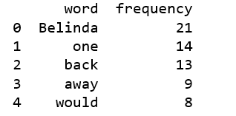
Observation:
Words below refers to the peak of the word frequency graph.
These words do not contribute much to the topic modelling.
Right , dude, last,would , week, can be used in any context doesn’t help us much.

Slide 9
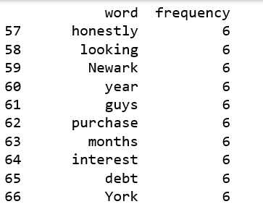
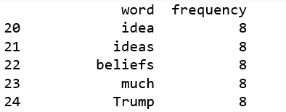
Observation:
Above screenshots show the words from same podcasts , which could give a much more meaning. Word frequency is much lesser .
These observations lead us to TF-TDF.
TF- IDF:- Term Frequency and Inverse document frequency.
TF:- The weight of a term that occurs in a document is simply proportional to the term frequency.
IDF:- The specificity of a term can be quantified as an inverse function of the number of documents in which it occurs.
Simple example From Data:- right low TF-IDF score.
Newark high TF-IDF score..

Slide 10
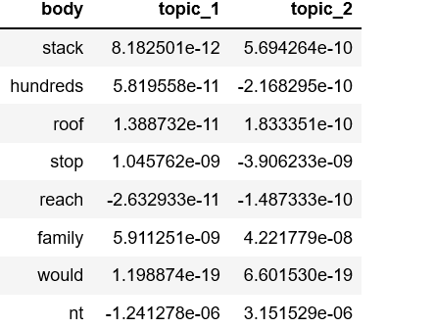
Harini
Latent Semantic Analysis(LSA)
LSA:-
LSA= TF-IDF +SVD(singular value decomposition)
Document matrix is formed using the TF-IDF score for each word.
To reduce the dimensionality of a matrix we use truncated SVD.

Slide 11
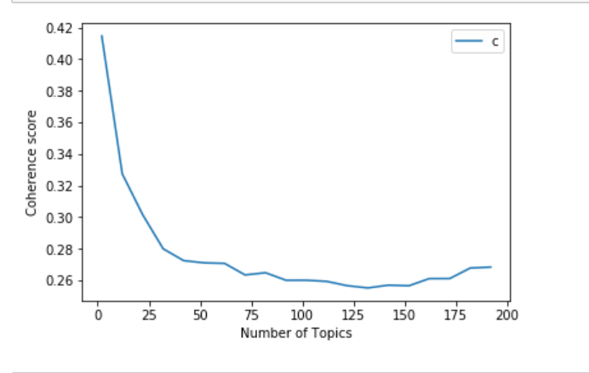
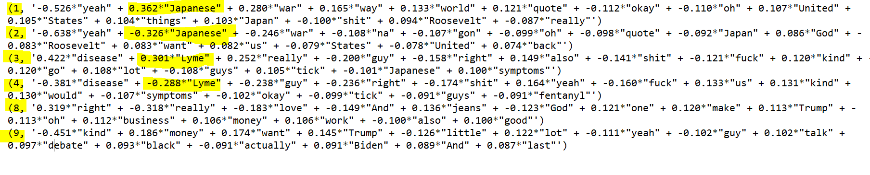
Harini
Results of LSA and Next Steps
Coherence measures the dependency of 2 signals.
Next Steps:-
Visualization and efficiency of LSA
Comparing it with LDA
Exploring a better topic model

Slide 12
Christopher
LDA Introduction
Consider each document as a collection of topics in a certain proportion.
Key Factors:
The quality of text processing.
Variety of topics discussed.
Choice of topic modeling algorithm.
Number of topics fed into algorithm.
Algorithm tuning parameters.
Why LDA over LSA or vice versa?
Compare results to find the most relevant topic model.
Notes:
Looked into both LSA and LDA to see which model will give better results.

Slide 13

Christopher
LDA Workflow
Notes:
Once data has had an LDA model applied there are many ways to visualize the data.

Slide 14
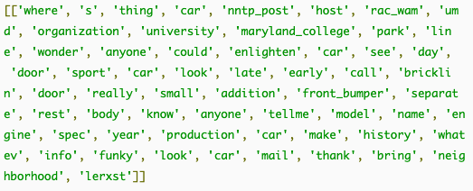
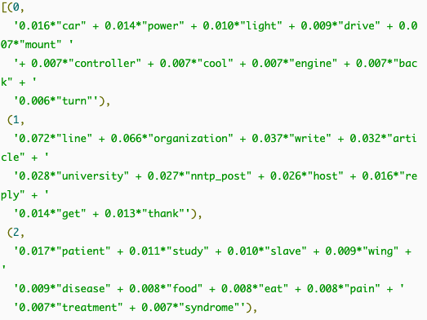
Christopher
LDA Data Example
Lammetized Data (Pre-Model)
Topics (Post Model)
(weight, keyword)
Notes:
Weight reflected how important that keyword is to the topic.
Lemmatization is the process of grouping together the different inflected forms of a word so they can be analysed as a single item.
Lemmatization is similar to stemming but it brings context to the words. So it links words with similar meaning to one word.

Slide 15
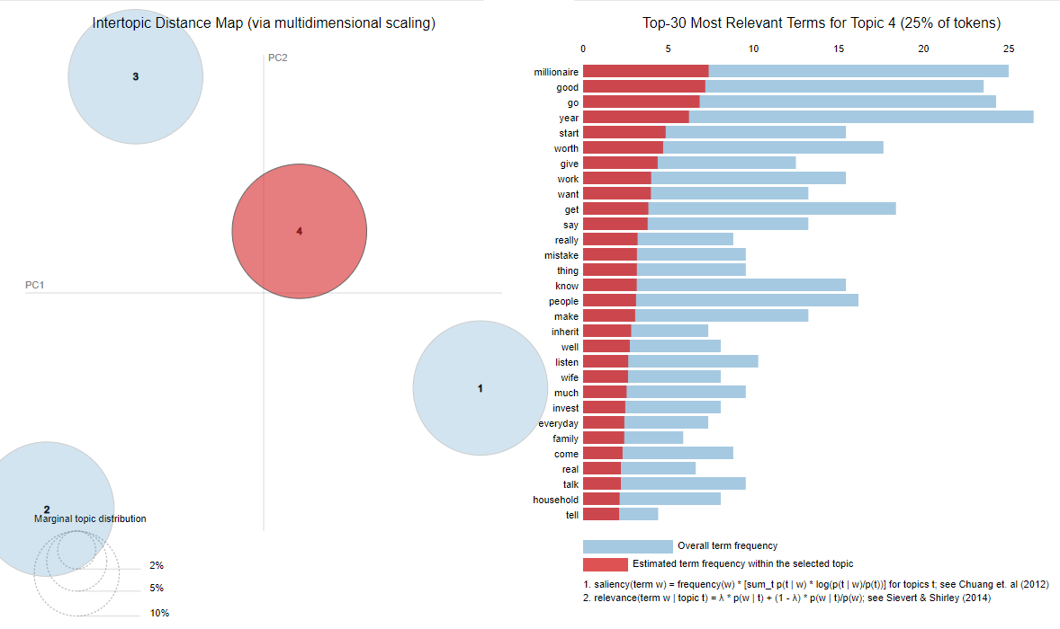
Christopher
LDA pyLDAvis Graph
Notes:
Once data has had an LDA model applied there are many ways to visualize the data. Right skewed distribution.

Slide 16
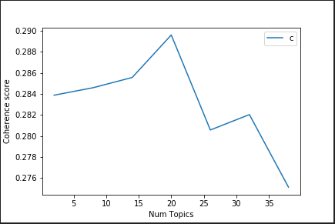
Christopher
LDA Coherence Score vs Topic Amount
Notes:
Once data has had an LDA model applied there are many ways to visualize the data.

Slide 17
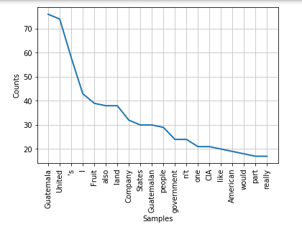
Christopher
Key Word Hypothesis
Pose the Question
Is there is a high likelihood that the words within the title will appear within the podcast?
Example Podcast: “Stuff You Missed In History Class - The 1945 Guatemalan Coup Part 2”
Notes:
Once data has had an LDA model applied there are many ways to visualize the data.

Slide 18
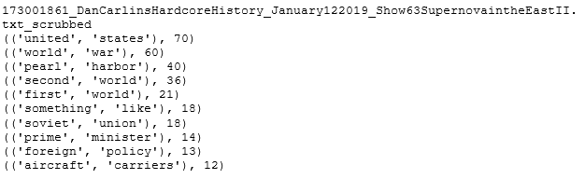
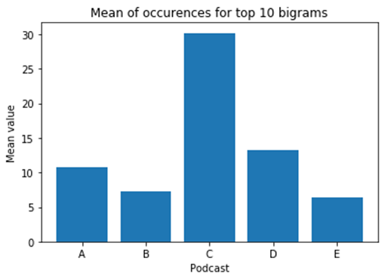
Jeremy
T 2.1 - Statistical Evaluation of Data
Acquired top 10 bigrams and their mean frequency per podcast to analyze topic discussion frequency

Slide 19
Jeremy
T 2.2 - Distribution Modeling
Many topic models built from bigrams seem to roughly follow binomial or hypergeometric distributions, as the model places primary confidence in one topic, then a secondary topic and lower confidence in others

Slide 20
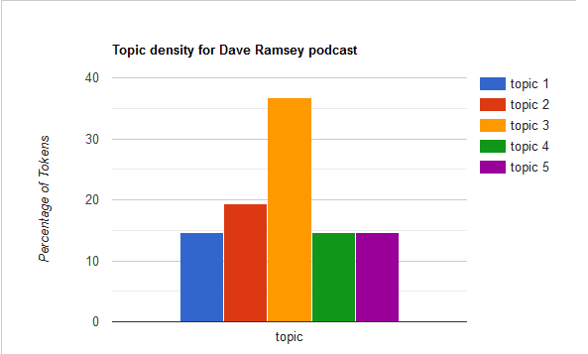
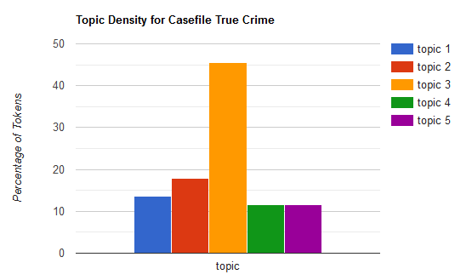
Jeremy
T 2.2 - Distribution Modeling

Slide 21


Jeremy
T 2.3 - Hypothesis testing
Do the bigrams obtained from NLTK that occur with the top 3 highest frequencies have a higher likelihood to contain word pairs within the podcast name or title than those with lower frequency for 10 sample podcasts?

Slide 22
Jeremy
T 2.4 - Correlation / Covariance
Collocations are words that have positive correlation, e.g. “public school”
Using the Natural Language Toolkit, it’s possible to determine the confidence with which two words are positively correlated in a meaningful way

Slide 23
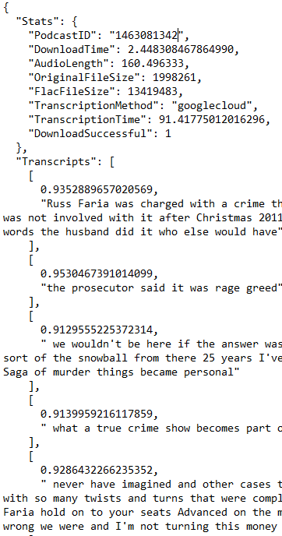
Jamie
Transcription Collector Rewrite
Needed more statistical data from the transcription process.
From a business perspective, this is valuable information because we can estimate and predict the cost of transcribing and storing audio files, and demonstrate how long the process will take.
Transcript Acquisition Data:
PodcastID, DownloadTime, Audio Length, Original File Size, Flac File Size, Transcription Method, Transcription Time, Download successful.
Transcripts: The confidence score followed by their transcript.

Slide 24
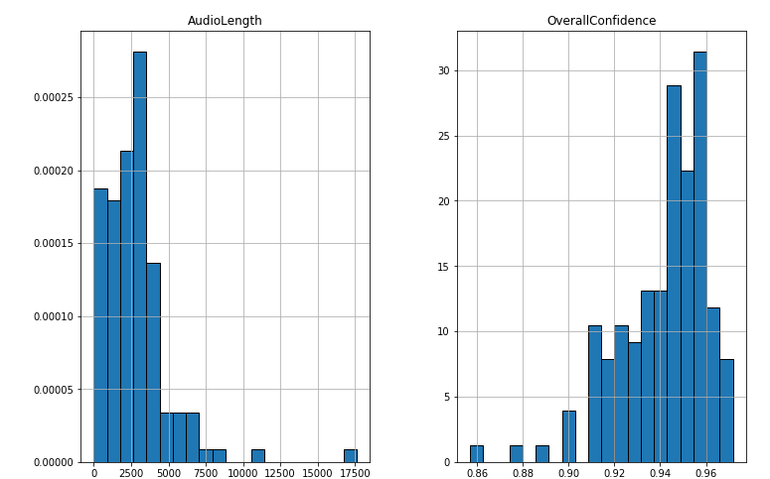
Jamie
Basic Statistics of Audio Length, Confidence Scores
Overall Confidence: The mean confidence score for the entire podcast.
Mean: 0.94124
Variance: 0.00039
Std dev: 0.01975
AudioLength: Duration of podcast in seconds
Mean: 2757.25
Variance: 4895670.35
Std Dev: 2212.61
*Generated from 133 samples.

Slide 25
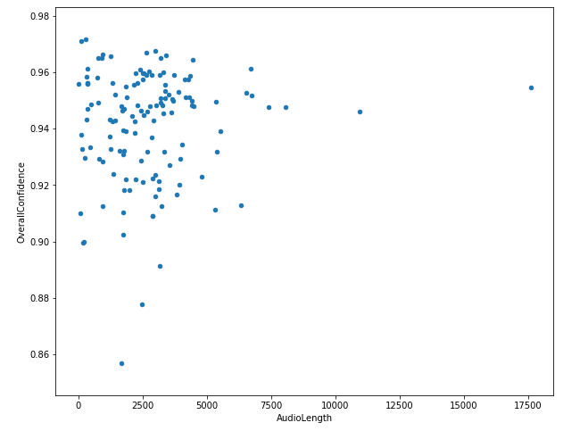
Jamie
Relationships
Is there a relationship between the length of a podcast and the overall confidence score?
Disappointingly, the answer appears to be no.
Hopeful for a correlation because I noticed some transcript "phrases" that were shorter had lower confidence scores.
Not the best approach because we're looking at a scatterplot of means. This was my "lazy" approach.

Slide 26
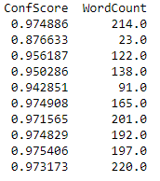
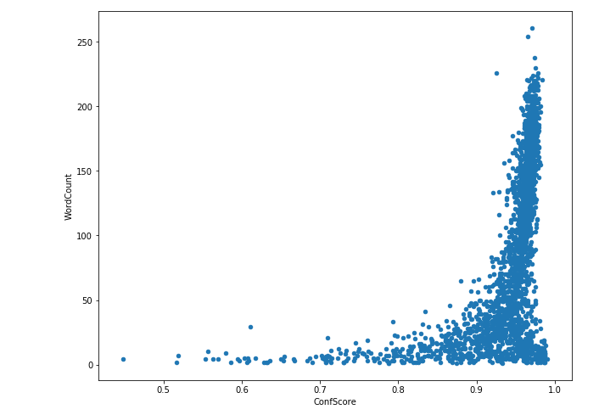
Jamie
Relationships
Second approach: Take the confidence score and see if there's a correlation between it and the word count of it's transcript phrase.
Performed across ALL podcast transcripts.
Looks like an exponential graph?

Slide 27
Jamie
Observations
Could Low word count and high confidence score be pauses in a sentences, slow pronunciations?
The higher the word count, generally the higher the confidence score.

Slide 28
Vincent
Task
Responsive in calculating the stats of google speech to text cost.
It is useful to understand the cost of each podcast.
Basic Stats of the total costs
Distribution models
Correlation and Co-variance
Hypothesis Testing

Slide 29
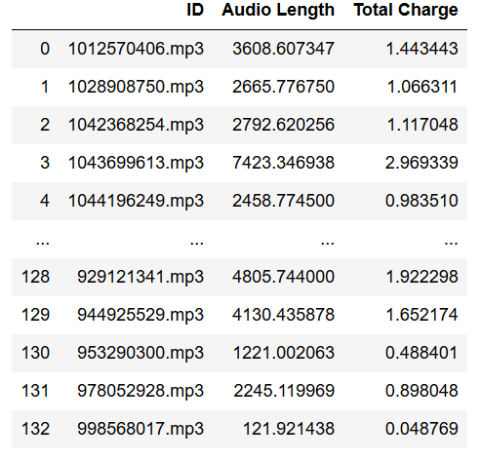
Vincent
Basic Stats
Mean: 1.1029031027909777
Variance: 0.777417
Median: 1.0134778624
STD: 0.8817129
Measures of Spread: 7.049205

Slide 30
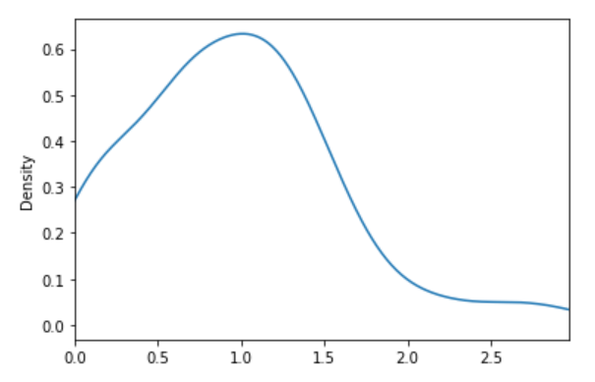
Vincent
Distribution Models

Slide 31
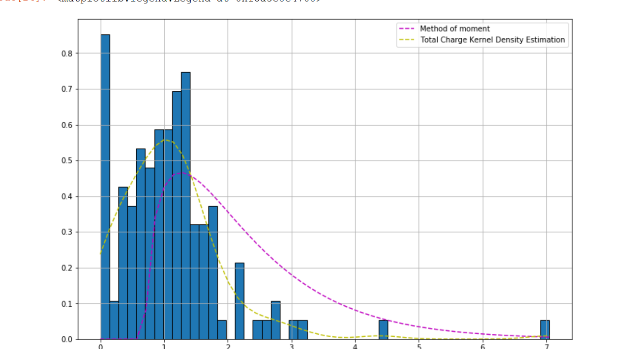
Vincent
Distribution Models: Estimator

Slide 32
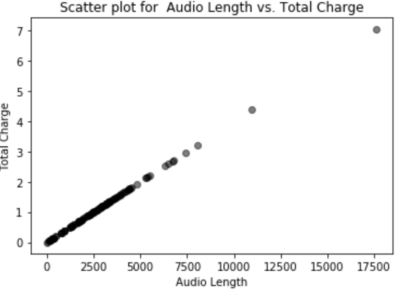
Vincent
Correlation
Since the data is calculated based on the Audio Length .
Cost = (AudioLength / 15 seconds) * 0.006 cent/sec.
Graph

Slide 33
Vincent
Hypothesis Testing
Pose The Question
What is the likely cost for each podcast?
Use current iteration as the sample size, then throughout the course, the application will have the ability to collect population size. Such that, the application can calculate the P-value with using one sample T-test.

